Slide 1
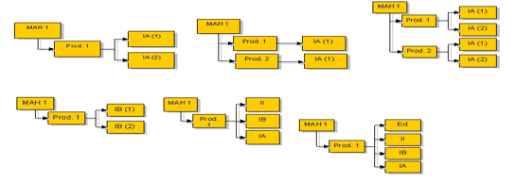
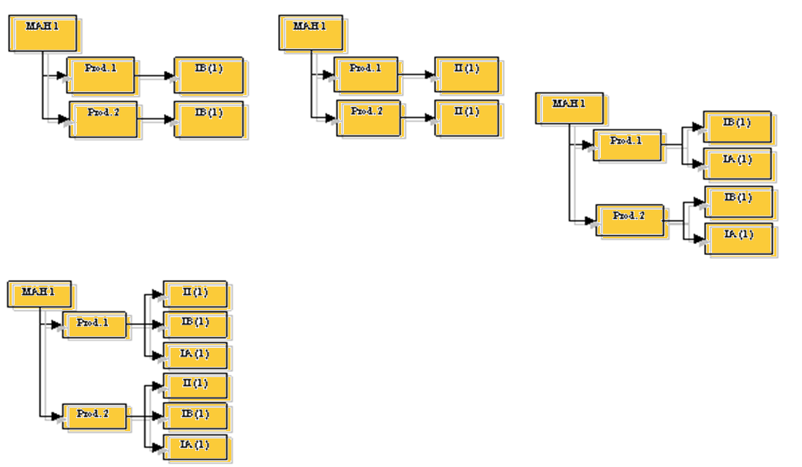
Top tips:
Variations and Mock-ups
Grouping
Worksharing
Grouping is permitted providing the requirements of the Regulation (EC) No 1234/2008 are met.
The worksharing procedure is intended to avoid duplication of work. It is possible for competent authorities to process under the same procedure variations to purely national, MR, decentralised and centralised MA’s.
A MAH can submit the same type IB or type II variation, or the same group of variations affecting more than one marketing authorisations from the same holder in one application. In case a grouped application is applied within a worksharing application, this may also contain consequential IA changes.
MRP/DCP MAs:
National MAs:
The same rules as for MRP/DCP with the following differences:
IA or Type IAIN changes
One change to several MAs
Several identical changes to several MAs
Several changes to one MA
Grouped applications are only possible within one single member state.
To group national MAs from different member states see worksharing procedures
Variations
Harmonisation of the complete initial dossier or SPC and product literature is not a prerequisite.
The variation application form must reflect the same ‘present’ and ‘proposed’ situation applicable to all MAs.
Type IA/ IAIN variations affecting several MAs is considered as a “group” of variations and not a “worksharing” procedure.
Partnership Initiative procedure is no longer available.
Extension are excluded from worksharing.
A number of changes may be applied for at the same time as a single application. At least one of the changes must be a Type IB, II or an Extension.
The changes must also fall within one of the cases listed in Annex III of the Regulation*, or, if they do not fall within one of the cases listed, all member states involved agree to progress the variation as a ‘group’.
One or several changes to several purely national MAs may be submitted as one grouped application, independent from the procedure type.
However, the changes have to be identical for all products concerned.
These procedures are handled according to the national rules of the relevant competent authority.
How to Group
How to do worksharing
http://www.ema.europa.eu/ema/index.jsp?curl=pages/regulation/q_and_a/q_and_a_detail_000100.jsp&mid=WC0b01ac058029bdd6
http://www.ema.europa.eu/ema/index.jsp?curl=pages/regulation/q_and_a/q_and_a_detail_000101.jsp&mid=WC0b01ac058029bdd7
New and Revised Mock Ups: Top Tips
Common Errors: Variations
Common Errors:Type IA, Type IA_{IN},
Type IB and Type II variation applications
Guideline page not submitted with the application form.
Missing documentation pertinent to the application.
Insufficient supporting documents.
Incorrect or inaccurate information filled in the present and proposed section of the application form.
Incorrect procedure type for the variation submitted.
Incorrect category chosen for the variation
New mock ups:
Revised mock ups:
Take into consideration the physical size constraints of the container.
Clearly indicate if joint labelled with the UK.
State the font size for all mock ups. The font size should be in line with the PLS.
Full colour mock ups of the smallest and largest pack sizes to be marketed should be submitted as a single pdf file.
Include the method of sale and supply and the VPA number.
Confirm the date on which the package leaflet was last approved will be updated at print.
Confirm the BN and EXP date will be overprinted on the packaging if it is not clear.
Do not submit annotated mock ups.
Should contain only the text agreed during the procedure and any additional national requirements as outlined in the PLS.
Only the notified change(s) should be incorporated in the mock ups.
The inclusion of the distributor on the mock ups is not a national requirement. If the applicant includes the distributor a national variation application (C.II.6.a – Type 1Ain) is required.
When joint labelled with the UK and changes are proposed to the UK only box, IE do not require a variation.
For joint-labelling procedures, refer to the clarification paper on joint labelling between Ireland and the UK for variation categories.
Where there are significant changes to the mock ups (e.g. layout and / or design), the font size should be stated and in line with the PLS.
The final version of mock ups should not be annotated.
There is no requirement to submit all mock ups unless impacted by the change.

