Slide 1
P O S S I B L E
F U T U R
E
N A T I O N A L
L E G I S L A T I O N
ARISING FROM THE NEW VETERINARY MEDICINAL PRODUCTS REGULATION
Frances MacAodháin
Department of Agriculture, Food and the Marine

Slide 2
P O S S I B L E F U T U R E NATIONAL L E G I S L A T I O N
O V E R V I E W
Giving effect to EU law via national legislation
What the new S.I. will do
Updates to Current Rules
New National Rules and Derogations
Next steps

Slide 3
P O S S I B L E F U T U R E N A T I O N A L L E G I S L A T I O N
R E G U L A T I O N
V
D I R E C T I V E
DIRECTIVE
Lays down certain results that must be achieved but each Member State is free to decide how to transpose directives into national law
REGULATION
Has binding legal force throughout every Member State and enters into force on a set date in all Member States

Slide 4
P O S S I B L E F U T U R E N A T I O N A L L E G I S L A T I O N
HOW A NATIONAL SI SHOULD GIVE EFFECT TO A REGULATION
1. Define the national competent
authorities, the controls and the
sanctions
2. Where the regulation refers to
national rules or derogations, these should be provided for.

Slide 5
P O S S I B L E F U T U R E N A T I O N A L L E G I S L A T I O N
UPDATING CURRENT RULES
C U R R E N T
D I F F E R E N C E S
Application process
Pharmacovigilance
Wholesaling
Retailing
Prescribing and dispensing
Cascade and
exceptional imports
Unlimited duration
no more periodic safety update reports
Valid throughout the EU
Internet sales
More complex, clinical diagnosis requirement, metaphylaxis, prophylaxis,
Aiming to increase availability

Slide 6
P O S S I B L E F U T U R E N A T I O N A L L E G I S L A T I O N
N A T I O N A L R U L E S &
D E R O G A T I O N S
Autogenous Vaccines
Electronic or paper package leaflet
Collection of usage data on antimicrobials
How to encourage reporting of adverse events
What qualifications should the new responsible person for wholesaling have?
Should we allow online sales of prescription only medicines in Ireland?

Slide 7
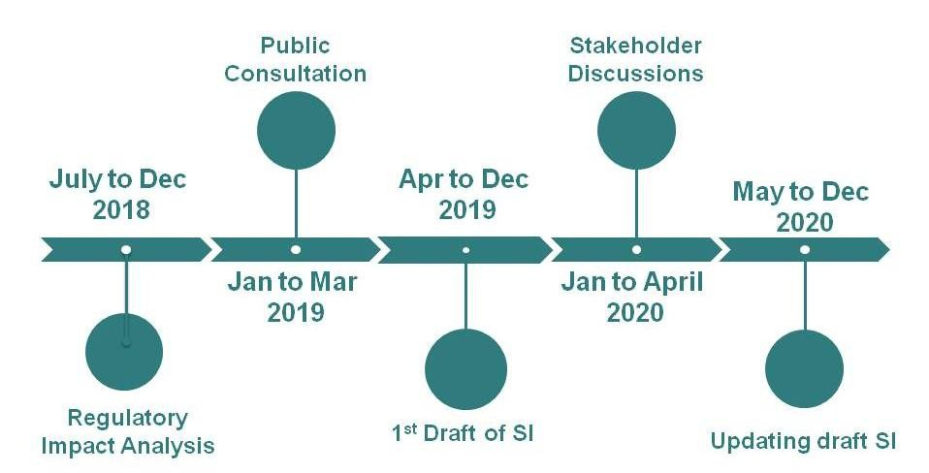
P O S S I B L E F U T U R E N A T I O N A L L E G I S L A T I O N
N E X T
S T E P S
S T A G E T I M E L I N E
Regulatory Impact Analysis Year end 2018
Public consultation 2. Public consultation - Begin
3. 1st draft - completed by ?? in ?
4. Stakeholder discussions - 3. 1st draft - completed by ??
5. 4. Stakeholder discussions -
5.

